Slide 1

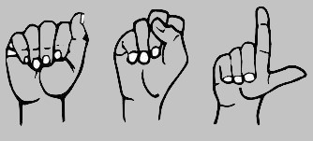
Sign Operated Alexa using
Sign Language MNIST

Slide 2

Efforts by
Project Under Supervision of
Mr. Niraj Haval
Vijay Disale - 44
Nilam Karande - 45
Rajeshwari Miraje - 46
Vaishnavi Lohar - 47

Slide 3
Introduction
The world is hardly alive without communication no matter whether it is in the form of texture , voice or visual expression.
The communication among the deaf and dump people is carried by text and visual expressions.
Sign language is learned by deaf and dump people and usually it is not known to normal people, so it becomes a challenge for communication between a normal and hearing impaired person.
‘Sign Operated Alexa’ system takes an input expressions from the hearing impaired person gives output to the normal person in the form of text.

Slide 4
Abstract
Our project aims to create a Web application and train a model which when shown a hand gestures of Sign Language it shows the output for that particular sign in text format on the screen.

Slide 5
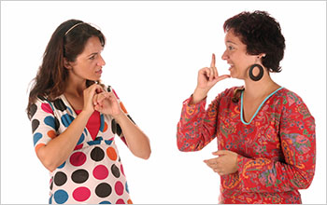
Objectives
To develop a system which would recognize the signs or gestures made by the deaf and dumb Person.
To design a web app for which converts meaning of sign while communicating with deaf and dumb person.
The objective of this project is to identify the symbolic expression through images so that the communication gap between a normal and hearing impaired person can be easily bridged

Slide 6

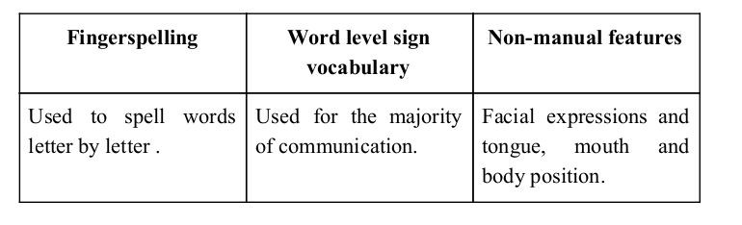
Sign language is a visual language and consists of 3 major components:

Slide 7
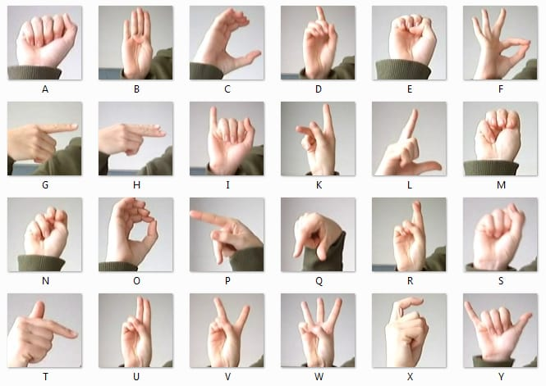
We implemented 24 symbols(A-Y) of in our project .

Slide 8
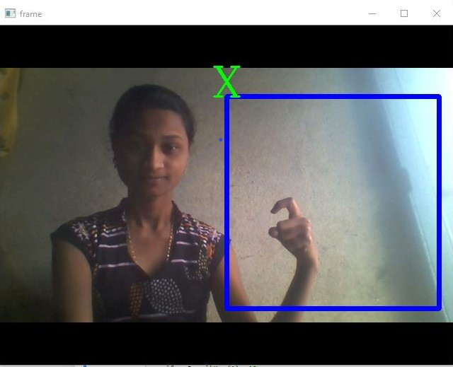

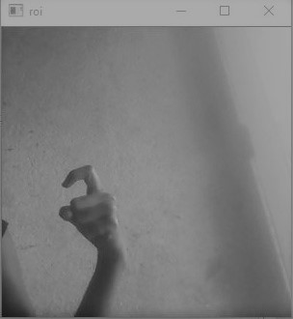
Image Pose Detection
Capturing Raw Image
Gray Scale Image

Slide 9
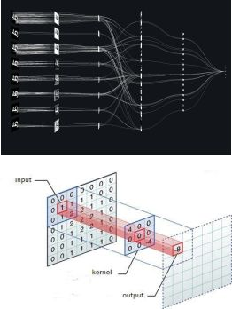

Convolutional Neural Networks
CNNs consist of multiple convolutional layers each layer containing numerous “filters” which perform feature extraction.
Initially these “filters” are random and by training, the feature extraction gets better by better.
It’s primarily used for image classification.

Slide 10
Algorithm Implementation
Apply gaussian blur filter and threshold to the frame taken with opencv to get the processed image after feature extraction.
This processed image is passed to the CNN model for prediction and if a letter is detected then the letter is printed and taken into consideration for forming the word.
We detect various sets of symbols which show similar results on getting detected.
We then classify between those sets using classifiers made for those sets only

Slide 11
Implementation
We had decided to work on the American sign language MNIST to train our model
here we used the kaggle MNIST dataset to train our model.
After that we assign some labels to extract columns data then using seaborn to plot the data in graphical format.
Then we inspect the image by visualizing the data.
After that we use opencv to training the dataset with gray scale images.
Then tensorflow model helped to train our dataset and reshape the image using keras and tensorflow model.
All the data then go through the CNN model and compile the model using this model.
After that it shows the accuracy plot of our model.
Then we uses webcam to train using unseen data and try to detect the appropriate result of model

Slide 12
Challenges Faced
One of the issue was to select a filter for feature extraction. We apply various filter including binary threshold, canny edge detection, gaussian blur etc. ,of which gaussian blur filter was giving better results.
Issues were faced relating to the accuracy of the model we trained in earlier phases which we eventually improved by increasing the input image size and also by improving the dataset.

Slide 13
Software Requirements
Python
Tensorflow
OpenCV
NumPy
Matplotlib
Keras
Seaborn
Juypter Notebook

Slide 14
Limitations of our model
The model works well only in good lighting conditions.
Plain background is needed for the model to detect with accuracy.
It detects only 24 letters .
Motion detection is not implemented right now.

Slide 15
Conclusion
In this report, a functional real time vision based sign language recognition for D&M people have been developed for MNIST alphabets.
We achieved an accuracy on kaggle dataset
Prediction has been improved after implementation of algorithms in which we verify and predict symbols which are more similar to each other.

Slide 16
Future Scope
We are planning to achieve higher accuracy even in case of complex backgrounds by trying out various background subtraction algorithms.
We are also thinking of improving the preprocessing to predict gestures in low light conditions with a higher accuracy.

Slide 17

Thank You !

